Slide 1
SharePoint 2007 Information Management Policy

Slide 2
Objectives
Understanding Information Policy Architecture
Creating Custom Policy Features
Creating and Using Policy Resources
Using Policies to Control Document Retention
Using Policies for Barcoding and Labeling

Slide 3
What is an Information Policy?
A non-invasive way to manage content
A collection of policy items (policy features)
Can be created at two scope levels:
Site Collection Level
Acts as a template for instances
Copied into lists and content types when assigned
MOSS propagates changes from template to instances
Content Type or List Level
Attached directly to the object, without creating a template
Can later be exported.

Slide 4
Information Policy Architecture

Slide 5
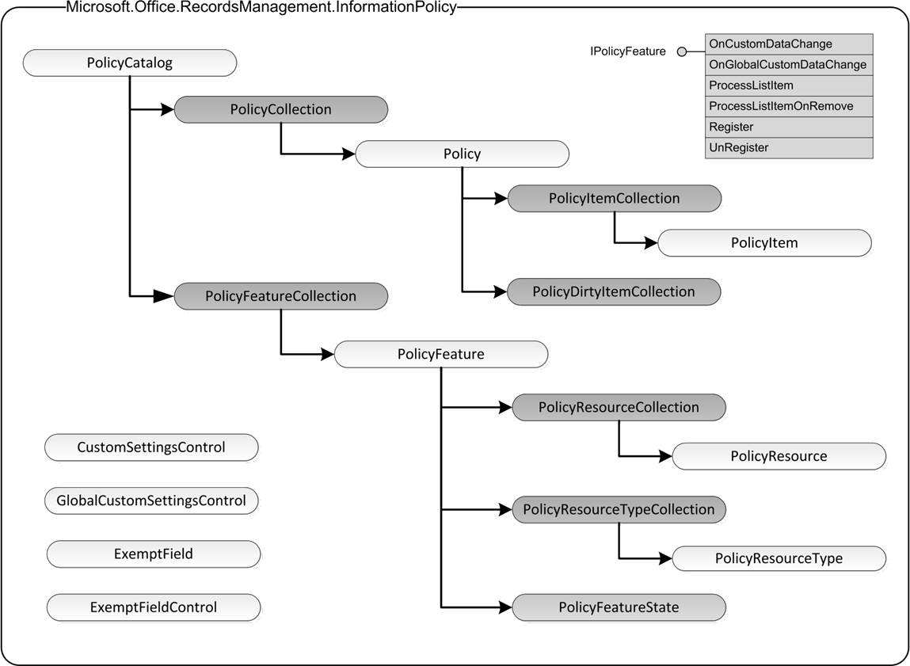
Information Policy API

Slide 6
Policy Features
What is a policy feature?
An assembly that adds content management functionality to…
MOSS, and optionally Office Clients
Implements IPolicyFeature interface
Installed into global catalog
Assembly must be in the GAC
May include custom administrative controls
Global Controls
in \12\TEMPLATE\ADMIN
Item-Level Controls
in \12\TEMPLATE\LAYOUTS

Slide 7
IPolicyFeature
Purpose
To handle changes in a policy
To propagate policy changes to list items
To handle removal of policy from list items
To register/unregister a policy item
Methods
OnCustomDataChange
OnGlobalCustomDataChange
ProcessListItem
ProcessListItemOnRemove
Register/Unregister

Slide 8
Built-In Policy Features
Barcode
Creates a unique identifier for a document
Generates a barcode image and inserts into document
Labeling
Searchable text area containing selected metadata
Provides a way to display metadata for printed documents
Can be used for list items as well as documents
Auditing
Provides a way to control auditing via information policy
Expiration
Enables the use of formulas to determine item expiration
Can specify actions to take when items expire

Slide 9
Policy Resources
Custom code that is called by a given set of policy features
Typically contains feature-specific code
May implement custom interfaces that policy features must know how to use
Deployed by adding definition (XML) to the policy resource list of a feature

Slide 10
Policy Event Processing
If policy item is added…
→ Register
If policy item is removed…
→ Unregister
If policy definition changes, or a new policy is attached to the list…
→ ProcessListItem
If policy feature settings change…
→ OnCustomDataChange
→ OnGlobalCustomDataChange

Slide 11
DEMO Information Policy

Slide 12
Policies in Content Types
Policies can be assigned to content types
Cannot change policy while assigned
Content Types inherit policies
Happens at instance level (when derived type is created)
Policy definition (XML) is copied into derived type
Changes to parent policy are propagated
Policy definition stored in content type payload
XMLDocuments
Policy definition copied into Office documents

Slide 13
Assigning Policies to Content Types
Cannot assign policies to ‘core’ content types
Item, Document, etc.
Must derive a new content type to add a policy

Slide 14
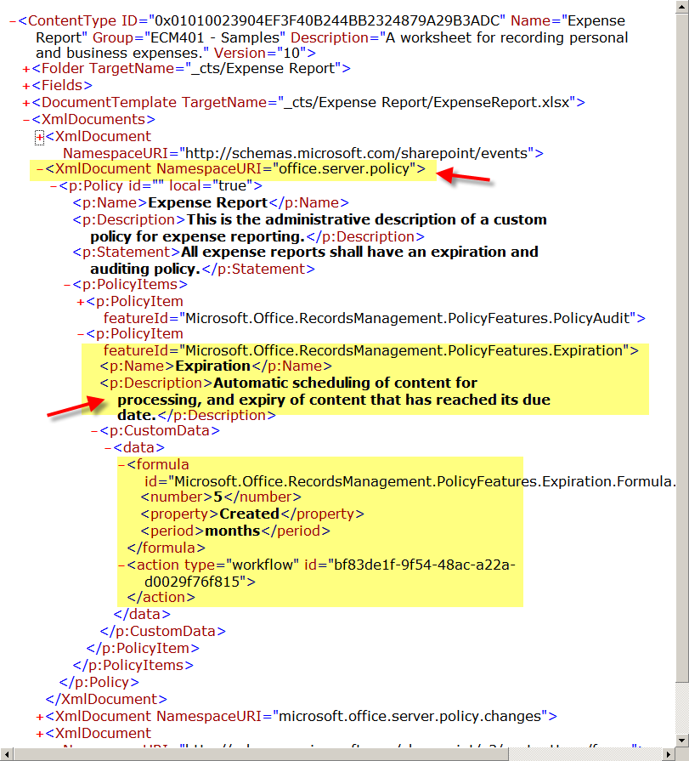
Policy Definitions in Content Types
Notes:
Here, we show clearly how a policy definition is bound to a content type. We do this by showing a content type definition before and after a policy has been applied. First, we create a content type through the UI. Then we use our content type browser utility to display the content types that have been defined for a given site. (this is a SharePoint Reflector demo) We then select the content type and show the CAML code. Next, use the UI to assign a policy to the content type. Then we refresh the content type browser and show the modified CAML code. Here we see exactly how the policy definition is added to the content type.

Slide 15
Designing a Policy
Items to consider:
The overall purpose of the policy
Characteristics of the target site collection
Scope
Multiple site collections?
Content-specific?
Location-specific?
Features
What features are required?
What resources are needed for each feature?

Slide 16
Policy Reporting
MOSS provides a default policy report
Provides a quick view of how policies are being used
Provides admin support for regulatory compliance
Configurable from Central Admin
Default report template can be opened from Excel
Can create custom report template (XML-SS)
Report includes:
Number of items using each policy
Summary of policy and each enabled feature

Slide 17
Managing Document Retention in WSS and MOSS

Slide 18
Agenda
Understand document retention requirements
Understand WSS/MOSS expiration architecture
Learn how to implement custom expiration formulas
Understand limitations of WSS/MOSS approach
Explore alternative strategies for handling expiration

Slide 19
Document Retention Background
Core requirement for any ECM system
Retention period driven by document type
Document Type | Recommended Retention
Bank Statement | 4 years
Budget | 2 years
Payroll Records | 6 years
Corporate Bylaws | Permanent

Slide 20
Document Retention Goals
Need to apply to any document types
Same formula for multiple document types
Different formulas for each document type
Need ability to change the expiration formula
Without changing the document
Without affecting already expired documents
Need to control what happens on expiration
Need to base expiration date on:
Fixed formula
External data
SharePoint data
Document metadata

Slide 21
Document Retention in SharePoint
Controlled by Information Management Policy
Built-in ‘Expiration’ Policy Feature
Policy defined separately from documents
Policy can be attached to:
Lists
Document Libraries
Content Types

Slide 22
Expiration Policy Feature

Slide 23
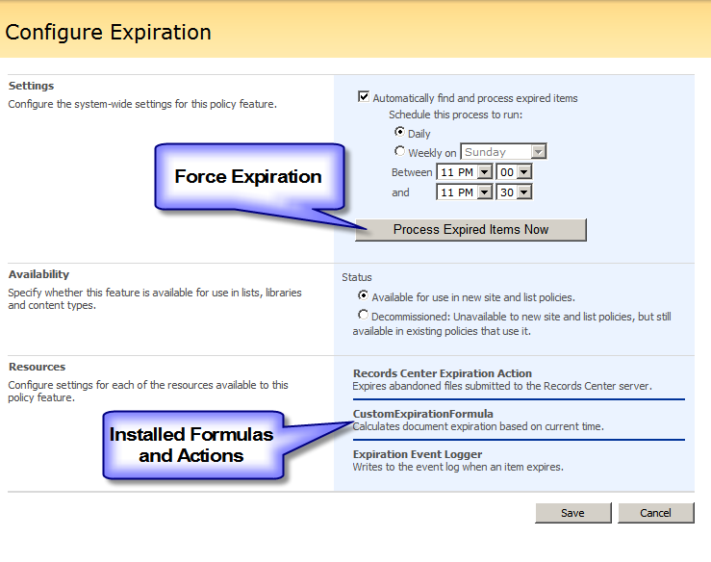
Expiration Policy Feature
Implemented as a SharePoint Timer Job
Configurable by Administrator
Can be forced to run:
via Central Admin
via custom code

Slide 24
Forcing Expiration via Code
foreach (SPService service in SPFarm.Local.Services) foreach (SPJobDefinition job in service.JobDefinitions) if (job.Title == “Expiration policy”) job.Execute(Guid.Empty);

Slide 25
DEMO: Expiration Policy Feature
Custom Expiration Formulas and Actions

Slide 26
Limitations
Information Management Policy Limitations
Only one policy per document library
Only one policy per content type
Expiration Policy Feature Limitations
Same expiration formula for all documents in policy

Slide 27
Solution Strategies
Don’t use Information Policy
Costly: must re-implement expiration timer job logic
Risky: may corrupt the content database
Don’t use expiration policy feature
Less costly: implement custom policy feature
Can access external expiration logic
Can access item metadata directly
Build a smarter expiration formula
Evaluate custom rules attached to item
Load and execute custom code configured at item level
AssemblyName + ClassName

Slide 28
Summary
WSS/MOSS provides an extensible framework for defining and applying custom information policies.
The WSS/MOSS Information Management Policy architecture is limited by the restriction of one policy per document library or content type.
The WSS/MOSS expiration policy framework is further limited by the common requirement to apply expiration policies along with other metadata-driven policies.
One strategy for overcoming such limitations is to build a secondary framework that evaluates custom rules attached to each document.

